Slide 1
Data Analyst

Slide 2
Living Area by Region

Slide 3
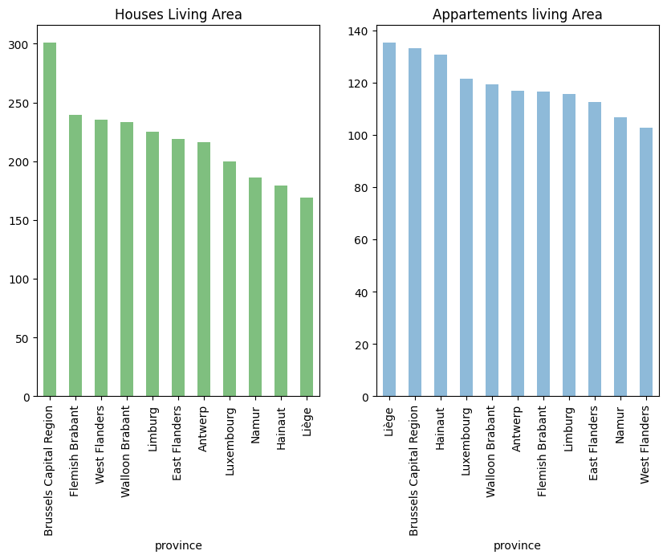

Slide 4
Real estate market in Belgium by region

Slide 5
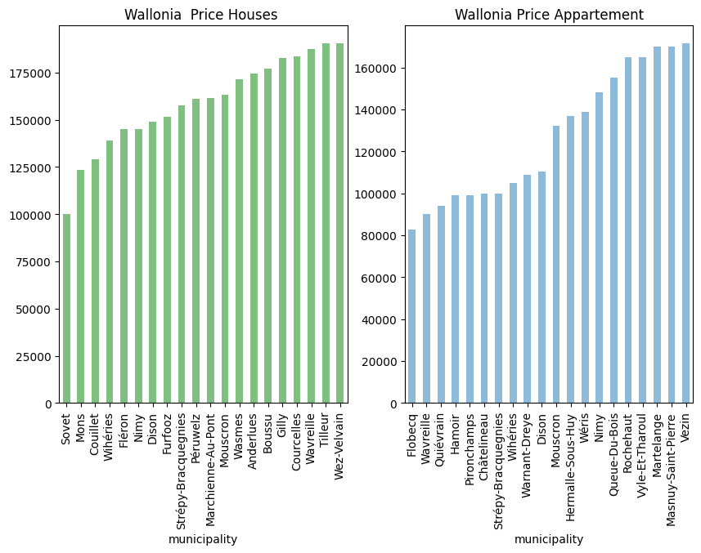
What are the less expensive municipalities in Wallonia?(Average price)

Slide 6
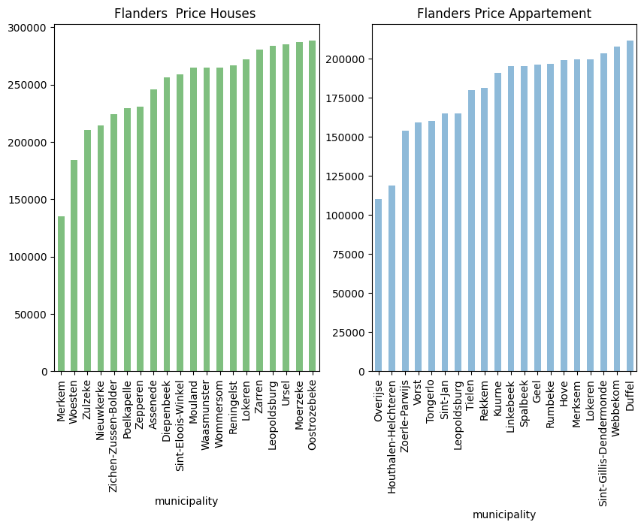
What are the less expensive municipalities in Flanders? (Average price)

Slide 7
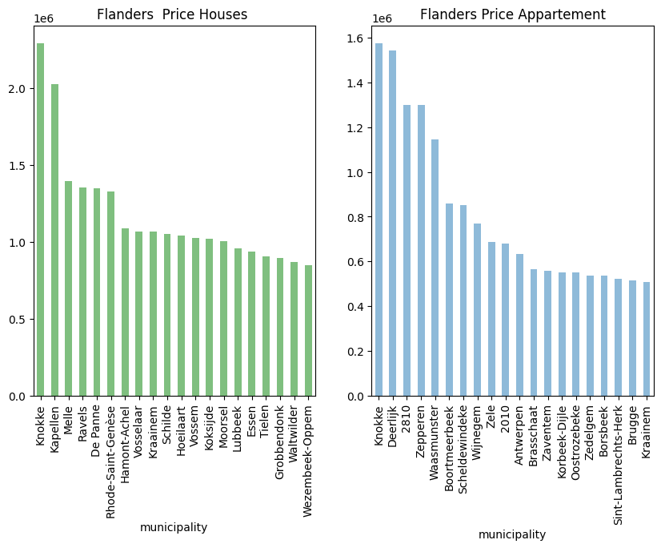
What are the most expensive municipalities in Belgium? (Average price)

Slide 8
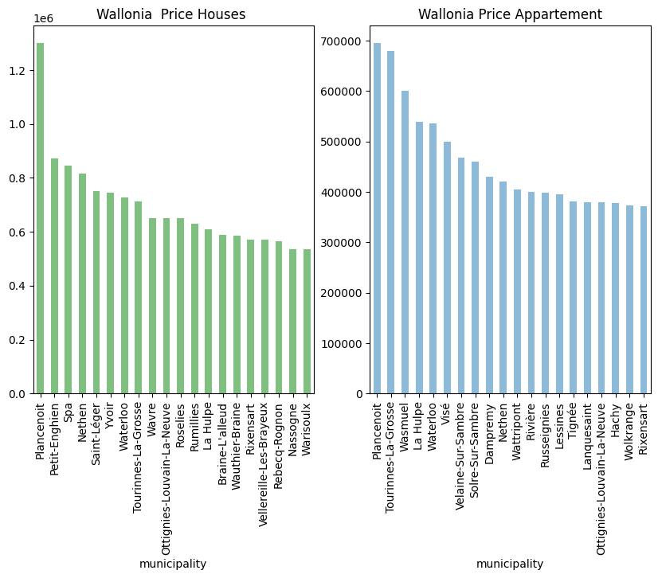
What are the most expensive municipalities in Belgium? (Average price)

